Slide 1
AI Cover Letter Generator
Job Post Killer
Group 10
Yat Chit Law
Karthikeyan Jeyabalasuntharam
Hiu Kwong Lung

Slide 2
Agenda
Technical:
ML Canvas
Model Benchmark
Model Deployment
Challenges and Future Enhancements
Demo
Business:
Problem Statement
Company background
Sale options and Costs
Strengths
KPI

Slide 3
Technical
01
Model Training and Deployment

Slide 4
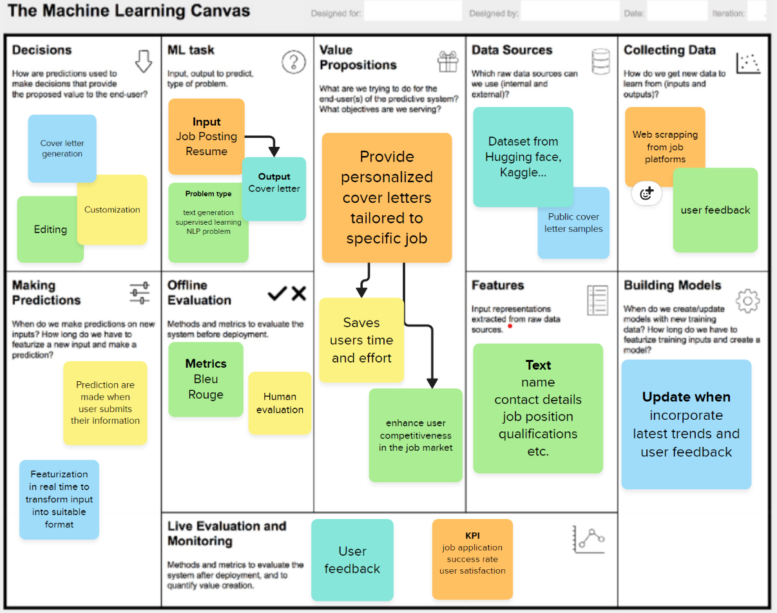
ML
Canvas

Slide 5
Model Benchmark
 | Bleu | loss | Accuracy | Time | Resource
Fine tune Bart - Baseline | 0.132 | 0.79 | 0.35 | 12h | CPU
Fine tune Bart - with hyper parameter tuning | 0.237 | 0.0063 | 0.47 | 2.2h | V100 GPU

Slide 6

Deployment
Deploy | Docker
Cloud | AWS
UI | Streamlit

Slide 7
Challenges and Future Enhancements
Challenges
Future Enhancements
Limited training resources
Model underperforming
Enhance personalization and customization
Improve model performance
Improve data extraction
Add user feedback ratings

Slide 8
Business
02
Company Planning

Slide 9

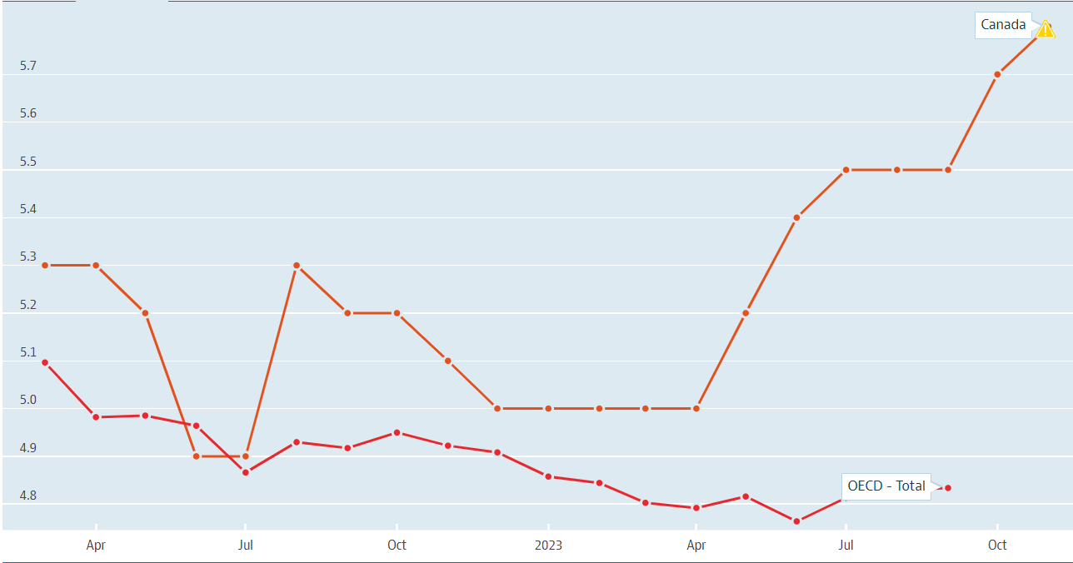
Problem Statement
Job Seekers' Common Challenges:
• Writing compelling cover letters is time-consuming and challenging, especially for those unfamiliar with personal branding.
• Most cover letters are generic, failing to capture unique qualifications or job demands.
• Applicants often overlook optimizing their cover letters for applicant tracking systems (ATS), which can automatically filter out unsuitable candidates.
Keep Rising!!!!
Unemployment rate Mar 2022 – Nov 2023

Slide 10
Company Background — Job Post Killer
Our app develop based on the challenges faced and job application frequency of recent graduates and career changers in the job market.
Insights:
Rising Demand for Precision-Targeted, Personalized Job Applications:
Rise in remote job applications.
Increased use of ATS software.
Existing tools offer limited customization, relying on templates.
Solution:
Unique AI Cover Letter Generator integrates job description analysis and the user's employment history.
Reduce the application time for each job posting to apply for more jobs.
Enhances the relevance of cover letter, increases chances of passing through ATS filters, and impresses hiring managers.

Slide 11
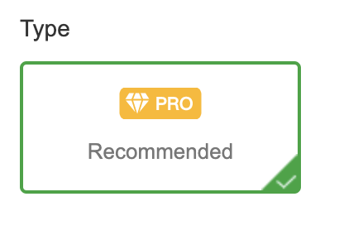





Sales Option and Costs
Sales option
Costs
Free Trial
Subscription-based
(Pro version)
API for career platform
(like LinkedIn)
Infrastructure
Hosting platform
(AWS Cloud $0.08/hours)
Training
Colab Pro($13.99/month)
Security
Data contain user sensitive information
Employee
Estimated Yearly Cost: $61,000

Slide 12
Data-Driven Personalization
User Friendly
Integration with LinkedIn
Strengths
Utilizes machine learning algorithms to create personalized cover letters.
Easy for job seekers of all levels to generate professional-quality cover letters in minutes by clicking a button
Allows users to import job descriptions from LinkedIn and produce customized cover letters efficiency

Slide 13
10000
+50%
80%
KPI
Use for our service
Efficiency for Applying a Job
User Satisfaction Rate

Slide 14

Demo

Slide 15

Thank you!
Contact Info
Mobile: +1 - (647) 223 3901
Email: jobpostkiller@gmail.com

